Slide 1
User Defined Function

Slide 2
User defined functions -
In programming, function refers to a segment that groups code to perform a specific task. Depending on whether a function is predefined or created by programmer; there are two types of function:
Library Function
User-defined Function
Library Function – Library functions are the built-in function in C programming. Programmer can use library function by invoking function directly; they don't need to write it themselves.
User defined Function - C allows programmer to define their own function. A user-defined function groups code to perform a specific task and that group of code is given a name(identifier). When the function is invoked from any part of program, it all executes the codes defined in the body of function.

Slide 3
Example 1: Library Function -
#include<stdio.h>
#include<math.h>
void main()
{
double number, squareRoot;
printf(“Enter a number: “);
scanf(“%d”,&number);
squareRoot = sqrt(number);
printf(“Square root= %d“,squareRoot);
}

Slide 4
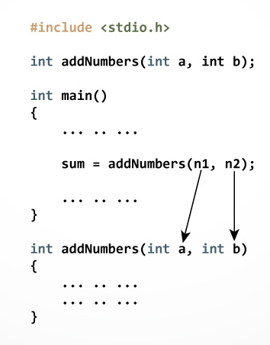
How user-defined function works in C Programming?

Slide 5
Example 2: User Defined Function -
#include<stdio.h>
// Function prototype (declaration)
int add(int, int);
void main()
{
int num1, num2, sum;
printf("Enters two numbers to add: “);
scanf(“%d %d”,&num1,&num2);
// Function call
sum = add(num1, num2);
cout << "Sum = " << sum;
}
// Function definition
int add(int a, int b)
{
int add;
add = a + b;
// Return statement
return add;
}

Slide 6
Different types of user defined functions -
With out return type, with out parameters
With out return type, with parameters
With return type, with out parameters
With return type, with parameters

